Slide 1
The Sun
and Sunspots

Slide 2
Sun Fun Facts
Diameter is 1,392,684 km
Mass 2x10^30kg
Equates for 99.86% of the solar systems mass

Slide 3
The Sun’s Rotational
Cycle

Slide 4
Our Data
The data has been taken through a H-Alpha filter.
Observations were taken everyday around noon as close as possible.

Slide 5

H-Alpha Filters
It is visible in the red part of the electromagnetic spectrum.
The H-Alpha line shows where the
hydrogen is being ionised.
H-Alpha hydrogen emission spectrum line

Slide 6
H-Alpha Filters
The probability of the electron being excited to n=3 without being removed it very small.
Within the new atom the electron will be in any energy level and so will try to cascade to the ground state (n=1).

Slide 7
Energy Level of Hydrogen
n=∞
0 eV
n=4
-0.85 eV
n=3
-1.51 eV
H-Alpha
n=2
-3.40 eV
n=1
-13.6 eV

Slide 8
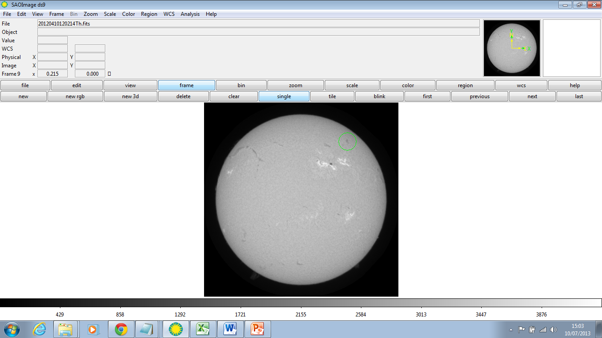
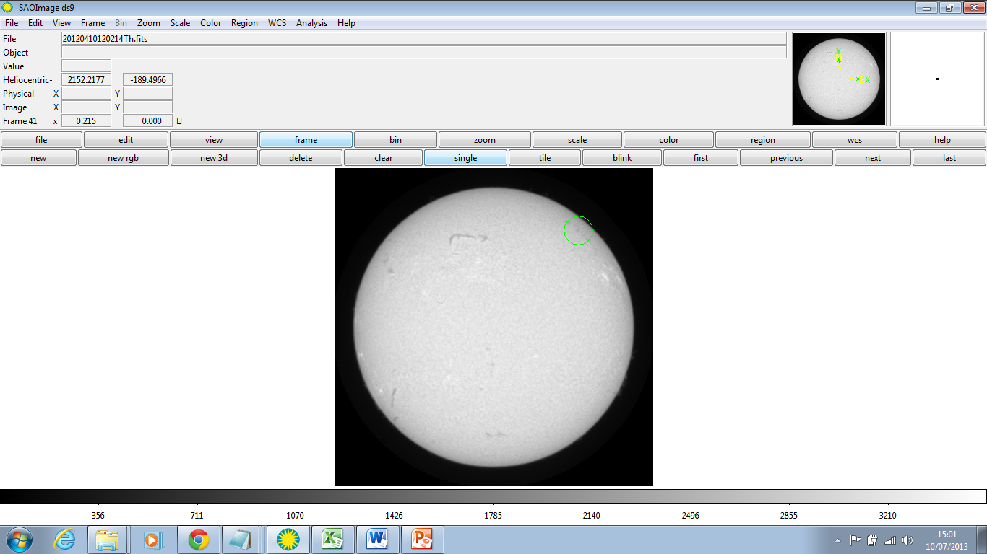
Polar Cycle
The polar cycle is longer than the equatorial cycle.
X=1512.857
Y=1638.306

Slide 9
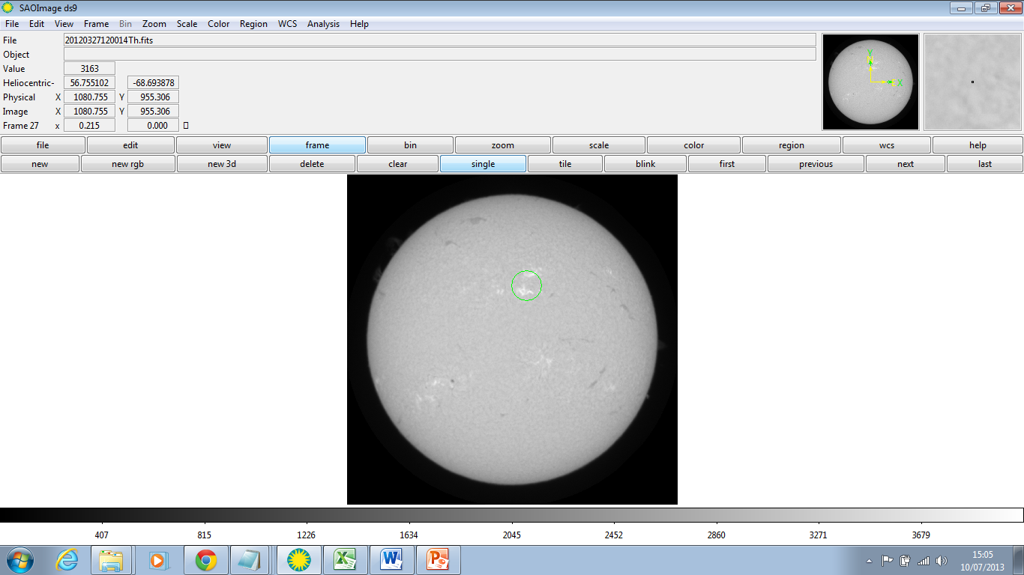
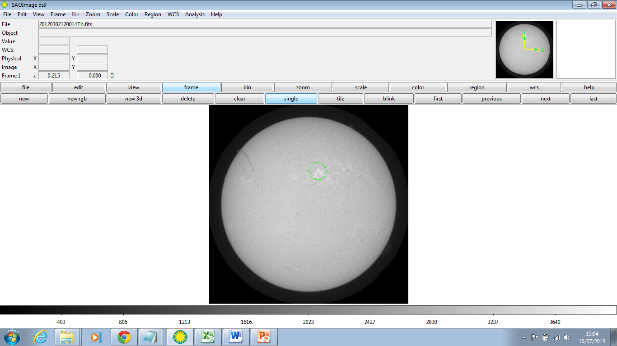
Equatorial Cycle
The equatorial cycle was shorter than the polar cycle.
X=1117.925
Y=1364.177

Slide 10
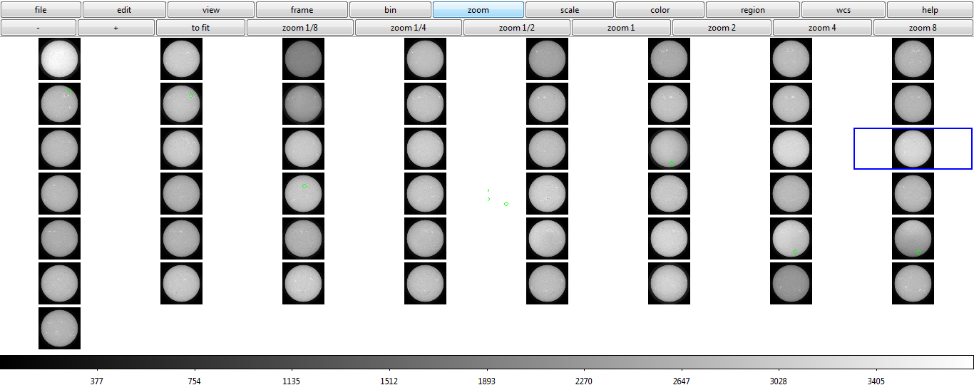
The Sun’s Cycle
We loaded 52 frames on to DS9 and analysed how suns spots in the polar and equatorial regions moved as the sun rotated.

Slide 11
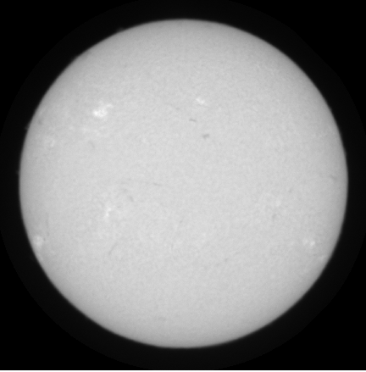

Slide 12
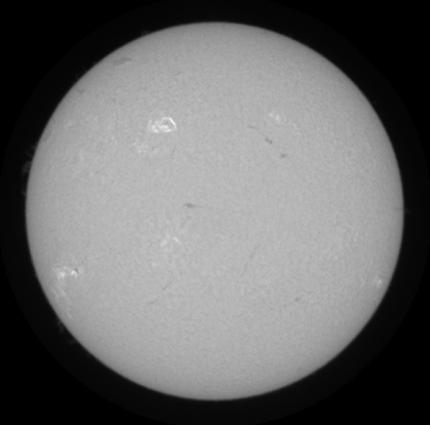

Slide 13


Slide 14


Slide 15
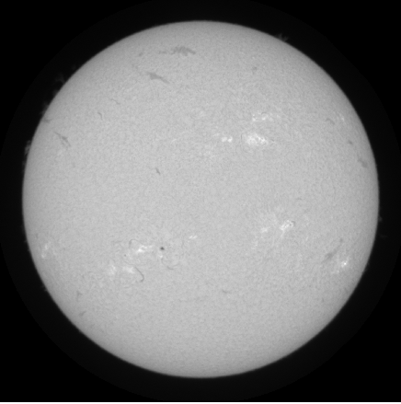

Slide 16
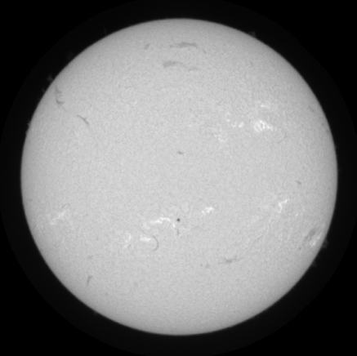

Slide 17
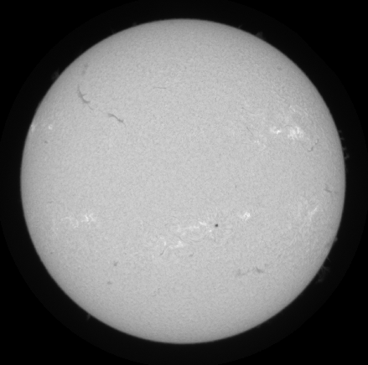

Slide 18
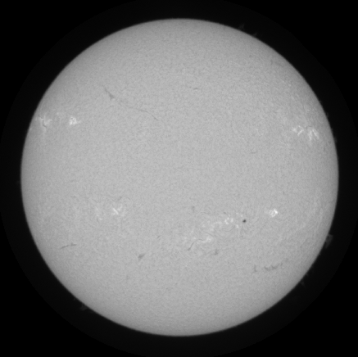

Slide 19


Slide 20


Slide 21


Slide 22


Slide 23
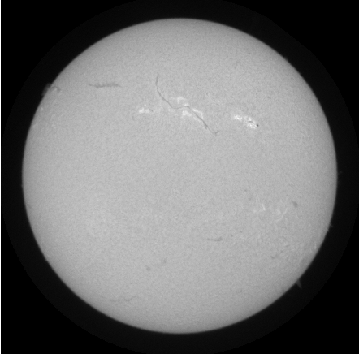

Slide 24
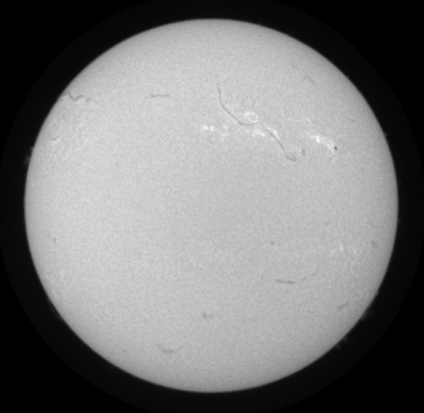

Slide 25


Slide 26


Slide 27
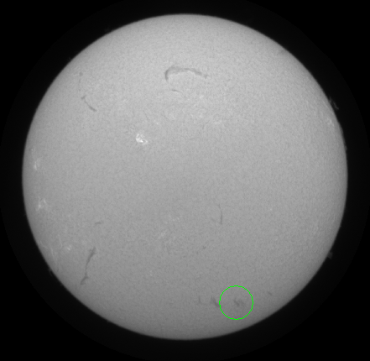

Slide 28


Slide 29


Slide 30


Slide 31


Slide 32


Slide 33


Slide 34
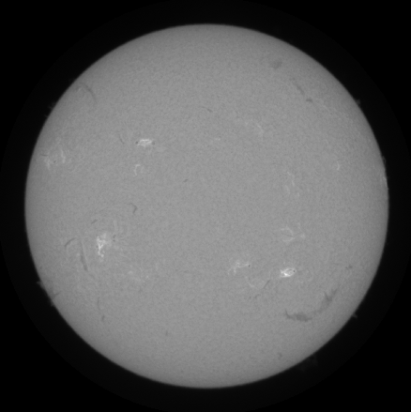

Slide 35


Slide 36


Slide 37
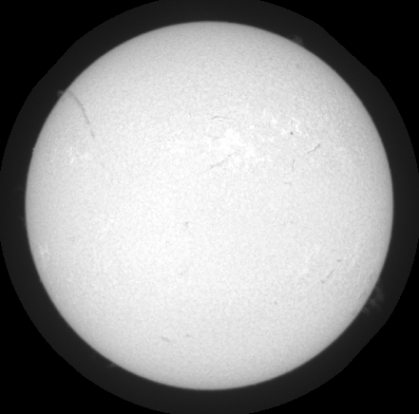

Slide 38


Slide 39
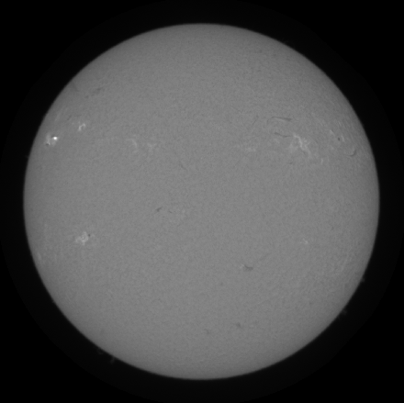

Slide 40


Slide 41


Slide 42


Slide 43


Slide 44


Slide 45


Slide 46


Slide 47
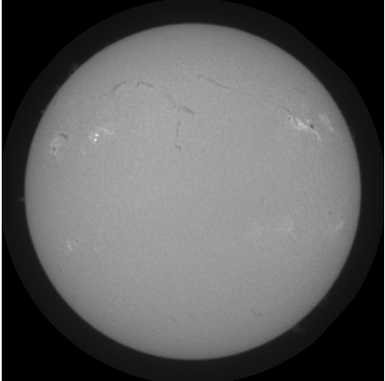

Slide 48


Slide 49


Slide 50


Slide 51


Slide 52


Slide 53


Slide 54


Slide 55


Slide 56


Slide 57


Slide 58
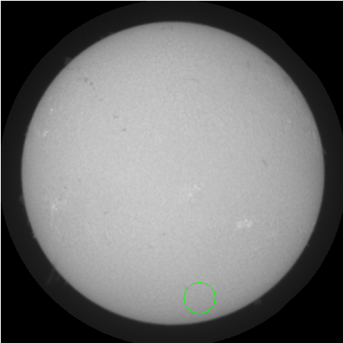

Slide 59


Slide 60
Sunspots

Slide 61
What are Sunspots?
They appear as dark spots compared to their surrounding regions.
The spot appears dark as it is much colder at around 3000-4500K (2700-4200°C) compared with the sun’s 5780K (5500°C)

Slide 62
What is the photosphere?
It is about 300 miles thick.
It has a composition of different gases including:
Hydrogen (73.46%)
Helium (24.85%)
Oxygen (0.77%)
and many other elements.

Slide 63
Why do Sunspots appear?
They usually appear as pairs, with each sunspot having the opposite magnetic pole than the other.
An eddy current brake is responsible for slowing an object through electromagnetic induction which creates resistance.

Slide 64
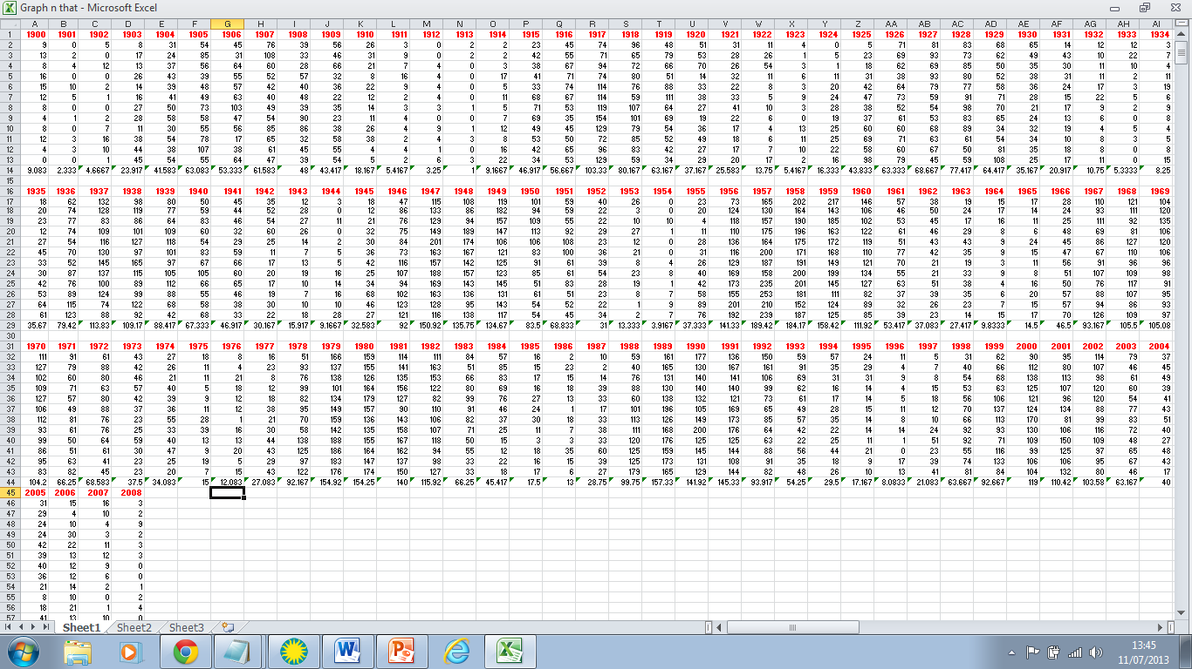
Sunspot Patterns
Around 1296 pieces of data for just the sunspots

Slide 65
Sunspot Patterns

Slide 66
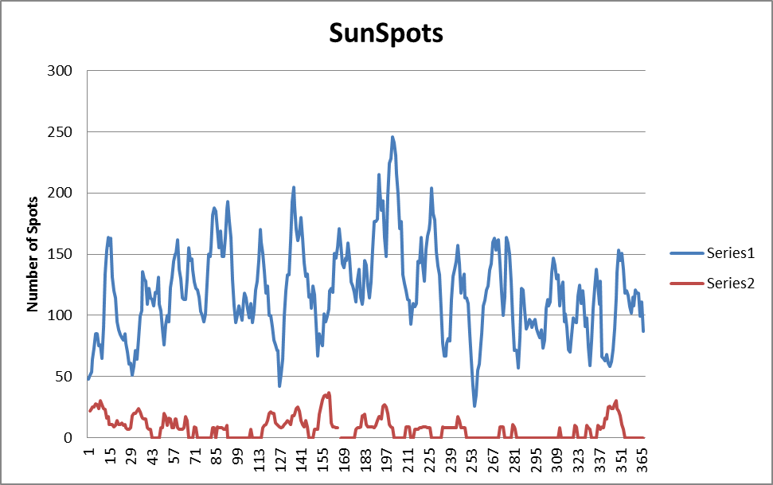
Sunspot Patterns
Year 2000
Year 2007

Slide 67
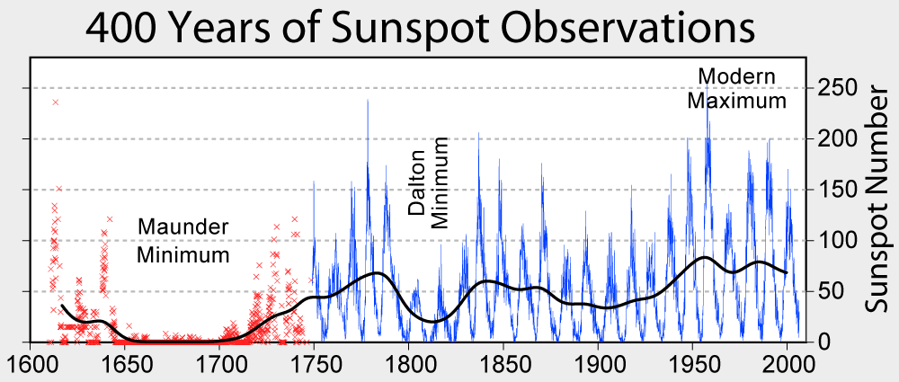
Sunspot Patterns
Our data matched previously gathered data very closely.

Slide 68
Thank you for watching!
Our super amazing life changing presentation.

Slide 69
By Abbie Chadwick John Buckley Patrick Heartless

